Slide 1
Wednesday, August 24, 2016
Write In Your Agenda:
Write In Your Monitoring Log:
CW:
Further discuss earth's layers
model of the earth's layers
fix our misconceptions
label & color pictures
HW:
None
Response to Warm-Up:
Do you agree or disagree with the following statement? Explain your thoughts.
There is more to the layers of the Earth than just "a bunch of rock".
You will need:
Pencil

Slide 2
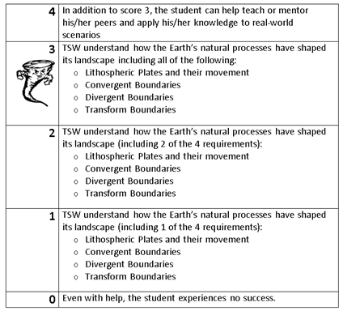
Learning Goal and Scale
TSW understand how the Earth’s natural processes have shaped its landscape (including Lithospheric Plates and their movement, Convergent, Divergent, and Transform boundary landforms).

